Slide 1
Lecture 2: Introduction to Computer Programming Course - CS1010
DEPARTMENT OF COMPUTER SCIENCE | 09/06/2019

Slide 2
Announcement
We will use Submitty (submitty.cs.rpi.edu ) for course content and homework submission.
Log in with your RCS Account and Password
Usually all home-works are posted on Tuesdays
Homework 1 will be posted tonight (Friday)
Due date will be Tuesday the 17th .

Slide 3
Goals
Install Miniconda/Anaconda on our Machines
Get Started with Spyder
Python as a Calculator
Variables and Expressions
Comparison Operators

Slide 4
Tooling Up
To Install Python we will use either
The free Anaconda Distribution or Miniconda Distribution.
Anaconda/Miniconda Can Be Installed on any major OS : Windows, Linux or MacOS.
Anaconda includes Python as well as many other useful Libraries including Spyder that we will use in this course.
Can use other IDEs (Integrated Development Environment) like Jupyter or IDLE.

Slide 5
Which One to Select?
Choose Anaconda if you:
Are new to conda or Python.
Like the convenience of having Python and over 150 scientific packages automatically installed at once.
Have the time and disk space—a few minutes and 300 MB.
Do not want to individually install each of the packages you want to use.
Choose Miniconda if you:
Do not mind installing each of the packages you want to use individually.
Do not have time or disk space to install over 150 packages at once.
Want fast access to Python and the conda commands and you wish to sort out the other programs later

Slide 6
Course Software Setup

Slide 7
Install Anaconda

Slide 8
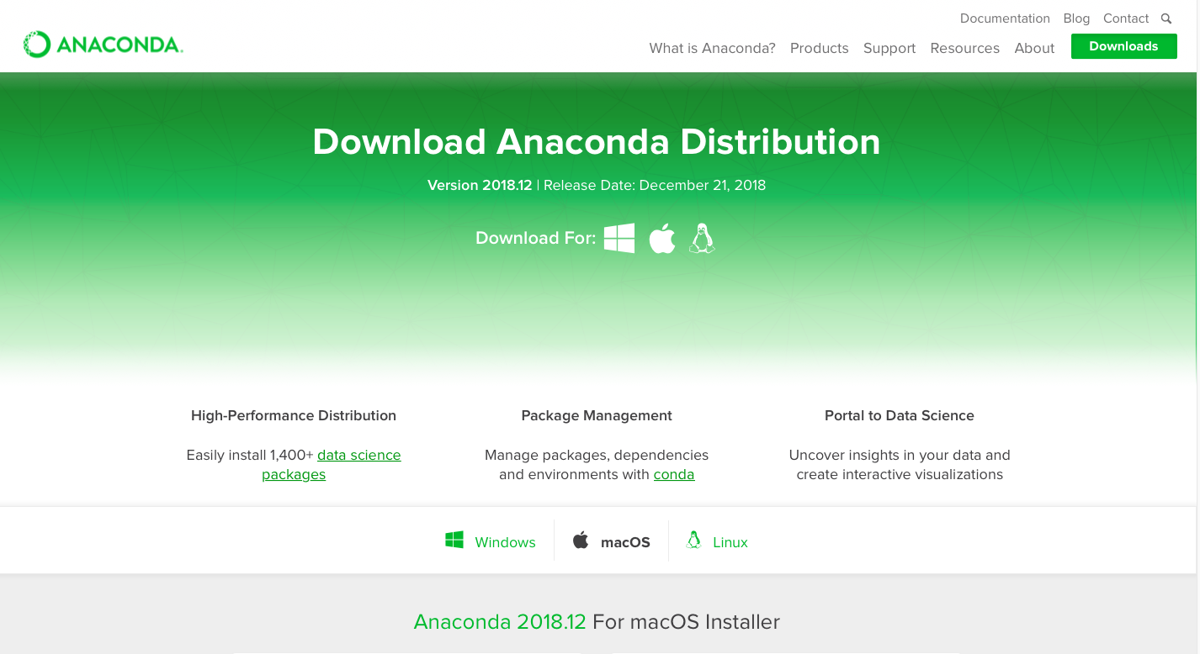
Download Anaconda: www.anaconda.com/downloads

Slide 9
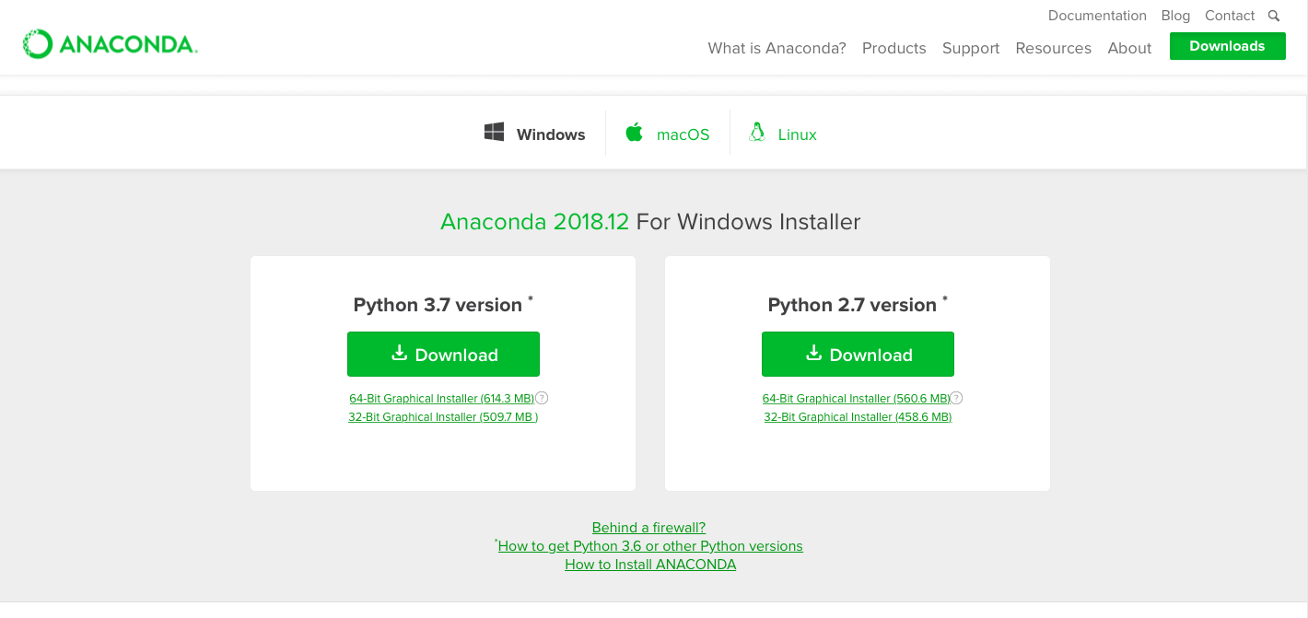
Select Windows, Mac or Linux.
Follow the instructions (Wizard will guide you through the process)
Guide : http://docs.anaconda.com/anaconda/install/ windows/

Slide 10
To Get Spyder
On the Windows Start Menu:
Go to Anaconda Navigator
Click Spyder
On Mac:
Go to Anaconda App through Launchpad
Click Spyder

Slide 11
Install Miniconda

Slide 12
Install Miniconda
https://conda.io/miniconda.html

Slide 13
Install (Windows)
Click on the downloaded file to start the installation. When the installer window appears,
Click Next to get started,
Click I Agree to accept the license terms, and
Then click Next to accept the defaults for the next several screens.
When you reach the screen with the Install button, verify the the two Advanced Options checkboxes to Add Anaconda to my PATH environment variable and to Register Anaconda as my default Python 3.7 are both checked. Then click Install.
When the install finishes, click Next then Finish. You can ignore the Anaconda Cloud window that pops up in your browser.

Slide 14
Install (Mac)
Click on OS X Miniconda install
Click on the Miniconda installer for OS X
On this page select the 64-bit (.pkg installer) for Python 3.7 and Mac OS X
Wait for it to download. It will place a file called Miniconda3-latest-MacOSX-x86_64.pkg in your downloads folder. On my computer using Safari this is ~/Downloads
Double click on the file to begin the installation
Follow the steps on the installer
Select the location you want Minicinda3 to be saved.

Slide 15
For Miniconda Get Spyder
For Windows
In the start menu open Anaconda Prompt
Type conda install spyder
Will take some time to download
Proceed ([y]/n)? y
Go to the start menu again and click on Spyder
For Mac: Go to the Terminal window (In Applications)
Uzmas-MacBook-Air:~ uzma$ cd ~/Applications
Uzmas-MacBook-Air:Applications uzma$ conda install spyder
Will take some time to download
Proceed ([y]/n)? y
Uzmas-MacBook-Air:Applications uzma$ which spyder
Usually in the bin folder within miniconda3

Slide 16
Spyder
For detailed information go to:
https://docs.spyder-ide.org

Slide 17
Before we begin
Please make sure all your installations are correctly done.
If not then please bring your computers to the instructor, TA or mentor for help.

Slide 18
Basic Elements of Python
A Python program is called a script: It is a sequence of definitions and commands.
These definitions are evaluated and the commands are executed by the Python interpreter in something called the shell.
A new shell is created whenever execution of a program begins.
A command, often called a statement, instructs the interpreter to do something.
Example: print (‘Hello World!’)
Is a command that makes the interpreter print:
Hello World!

Slide 19
Jump in to our first Program!
We create a file called hello.py containing just the two lines of Python code:
print('Hello, World!’)
print('This is Python')

Slide 20
Objects and Operators
Objects are the core things that Python programs manipulate.
Every object has a type that defines the kinds of things that programs can do with objects of that type.

Slide 21
Object types for numeric data
Name | Type (representation) | Example
Integers | int | Whole Numbers: 1, 5 , 7500
Floating Point | float | Decimal: 2.3, 4.6, 23.15

Slide 22
Types of numbers
Python has various "types" of numbers. We'll mainly focus on integers and floating point numbers.
Integers are just whole numbers, positive or negative. For example: 2 and -2 are examples of integers.
Floating point numbers in Python are the ones that have a decimal point in them, or use an exponential (e) to define the number.
Throughout this course we will be mainly working with integers or simple float number types.
Lets do some practice in Spyder.

Slide 23
Numbers
We'll learn about the following topics:
1.) Types of Numbers in Python
2.) Basic Arithmetic
3.) Differences between classic division and floor division
4.) Assignment in Python

Slide 24
Variable assignment
In this section:
We've seen how to use numbers in Python as a calculator let's see how we can assign names and create variables.
Variables are placeholders in Python that hold a value
These can be referred to again and again in a program

Slide 25
Assigning and Re-Assigning Variables
Variable assignment follows `name = object`, where a single equals sign `=` is an ‘assignment operator’
Python lets you re-assign variables with a reference to the same object using a short cut.
Python lets you add, subtract, multiply and divide numbers with reassignment using `+=`, `-=`, `*=`, and `/=`.
Let us try in Spyder.

Slide 26
Dynamic Typing
Python uses ‘dynamic typing’, meaning you can reassign variables to different data types.
This makes Python very flexible in assigning data types; it differs from other languages that are ‘statically typed’.
Lets check in Spyder

Slide 27
Variable Names
The names you use when creating these labels need to follow a few rules:
1. Names can not start with a number.
2. There can be no spaces in the name, use _ instead.
3. Can't use any of these symbols :'",<>/?|\()!@#$%^&*~-+
4. It's considered best practice that names are lowercase.
5. Avoid using the characters 'l' (lowercase letter el), 'O' (uppercase letter oh), or 'I' (uppercase letter eye) as single character variable names.
6. Avoid using words that have special meaning in Python like "list" and "str"
Using variable names can be a very useful way to keep track of different variables in Python. For example: (Go to Spyder example)

Slide 28
Determine Variable Type
You can check what type of object is assigned to a variable using Python's built-in `type()` function. Common data types include:
int (for integer)
Float (for decimals)

Slide 29
User Input
User enters the values in the Console and that value is then used in the program as it was required.
To take input from the user we make use of a built-in function input().
Let’s try in Spyder.

Slide 30
For Next Lecture
Now you have the necessary tools required to write programs that involve calculations

